Slide 1
Multiple Linear Regression
A Machine Learning Approach

Slide 2
Contents
01
02
Multiple Linear Regression-Recap
Inferential vs ML Approach
03
04
Cross-Validation
Hold-Out Method of Cross-Validation
05
06
K-Fold Cross Validation
Repeated K-Fold Cross Validation and LOOCV

Slide 3
Multiple Linear Regression-Recap
Multiple linear regression is an extension of simple linear regression, representing a more sophisticated approach to predictive modeling. It is used when we want to predict the value of a continuous variable based on the values of two or more other variables simultaneously.
Dependent Variable
The variable we want to predict is called the dependent variable (or sometimes the response variable). This is the outcome we're trying to understand and predict.
Independent Variables
The variables used to predict the value of the dependent variable are called independent variables (or sometimes, the predictor, explanatory, or regressor variables).
Model : Y = b₀ + b₁x₁ + b₂x₂ + ... + bₚxₚ + e
Estimation Method: Parameters of the model are estimated using the Least Square Method, which minimizes the sum of squared differences between observed and predicted values.

Slide 4
Data Background
The dataset includes employee performance as the dependent variable and four recruitment-stage assessment scores as independent variables.
1. Dependent Variable
Job Performance Index (JPI) – The outcome measure representing employee performance after the probationary period. This is what we aim to predict.
2. Independent Variables
Aptitude: General aptitude test score
Test of Language (TOL): Language proficiency score
Technical: Technical knowledge assessment
General: General knowledge evaluation

Slide 5
Data Snapshot
empid | jpi | aptitude | tol | technical | general
1 | 45.52 | 43.83 | 55.92 | 51.82 | 43.58
2 | 40.10 | 32.71 | 32.56 | 51.49 | 51.03
3 | 50.61 | 56.64 | 54.84 | 52.29 | 52.47
4 | 38.97 | 51.53 | 59.69 | 47.48 | 47.69
5 | 41.87 | 51.35 | 51.50 | 47.59 | 45.77
6 | 38.71 | 39.60 | 43.63 | 48.34 | 42.06
7 | 31.64 | 61.08 | 39.09 | 41.25 | 37.00
8 | 59.84 | 53.38 | 61.13 | 58.08 | 52.28
9 | 53.92 | 56.75 | 60.62 | 53.28 | 54.01
10 | 50.01 | 61.31 | 44.69 | 54.18 | 49.14

Slide 6
Regression Results: Inferential Approach
Variable | Coefficients | Standard Error | t Stat | P-value
Intercept | -54.2822 | 7.3945 | -7.3409 | 0.0000
aptitude | 0.3236 | 0.0678 | 4.7737 | 0.0001
tol | 0.0334 | 0.0712 | 0.4684 | 0.6431
technical | 1.0955 | 0.1814 | 6.0395 | 0.0000
general | 0.5368 | 0.1584 | 3.3890 | 0.0021
Significant Predictors
Aptitude, Technical, and General have P-values < 0.05. These three variables have statistically significant effects on job performance.
R²-Measure of Goodness of Fit
R² value for the case study is 0.88. Therefore, 88% of the variation in job performance index is explained by the model and 12% is unexplained variation.

Slide 7
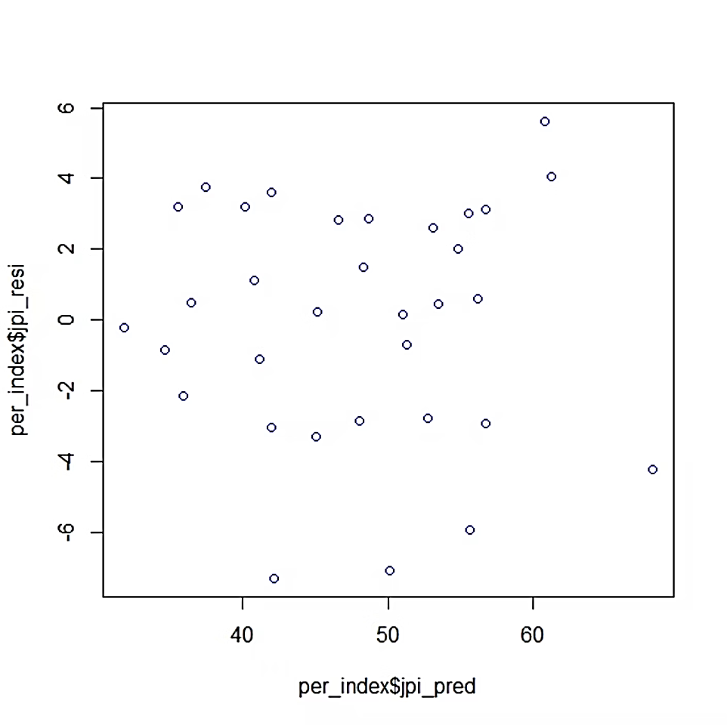
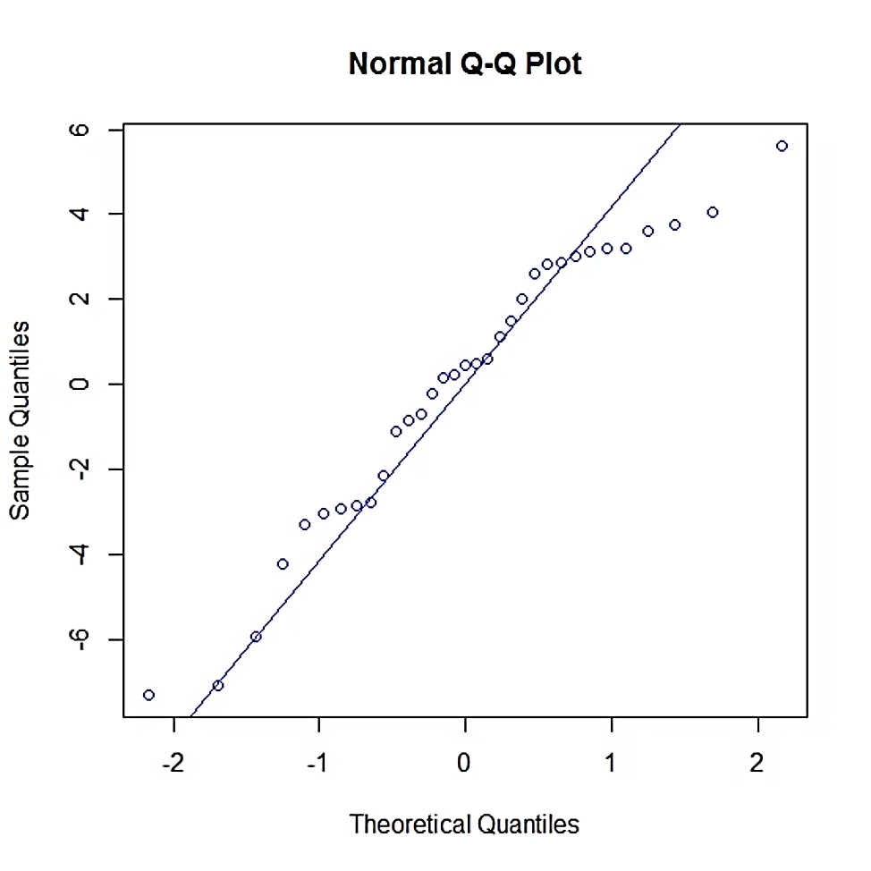
Residual Analysis-Necessary for Statistical Inference
The residual plot displays residuals on the y-axis against predicted values on the x-axis. This diagnostic tool reveals violations of regression assumptions. The q-q plot is used to assess the normality of errors.
Residual Plot
Q-Q Plot
Random pattern of residuals and q-q plot indicate that assumptions of “Constant Error Variance” and “Normality” are not violated.

Slide 8
Inferential vs Machine Learning Approach
Key Differences in Approach and Purpose
Objective
The machine learning approach aims to make accurate predictions for new or unseen data.
The inferential (statistical) approach aims to understand relationships between variables and determine whether independent variables have a statistically significant effect on the outcome.
2. Focus
Inferential regression focuses on explaining and interpreting the effects of independent variables.
ML regression focuses on model performance and generalization, not always interpretation.

Slide 9
Inferential vs ML Approach: Evaluation and Assumptions
3. Evaluation Criteria
Inferential approach uses statistical measures such as p-values, confidence intervals, R², F-test to assess model quality.
ML uses RMSE, MAE, MSE, cross-validation using train-test split to measure prediction accuracy.
4. Assumptions
Inferential requires strong assumptions: normality of errors, homoscedasticity, independence, no multicollinearity.
ML is less strict about assumptions and is mainly concerned with prediction performance.

Slide 10
Inferential vs ML Approach: Variable Selection and Interpretability
5. Variable Selection
In inferential approach, variables are chosen based on theory, significance, and p-values.
In ML, variables are chosen based on predictive power, often using techniques like Lasso, Ridge, feature importance, and automated selection.
6. Interpretability
Inferential models are highly interpretable, with clear meaning for coefficients.
ML models are less interpretable, coefficients may not be meaningful; emphasis is on prediction quality.

Slide 11
Inferential vs ML Approach: Overfitting and Data Requirements
7. Overfitting Control
Inferential models control overfitting using model simplicity and parsimony.
ML uses regularization, cross-validation, and early stopping.
8. Data Requirements
Inferential works with smaller datasets where theoretical understanding matters.
ML generally performs best with large datasets.

Slide 12
Cross Validation in Multiple Linear Regression
Cross Validation is a
process of evaluating the model on
‘Out of Sample’ data
Model performance measures such as R-squared or Root Mean Squared Error (RMSE) tend to be optimistic on 'In Sample Data‘
Model performance on “Out of sample” data gives more realistic picture of model performance.
Cross validation is important because although a model is built on historical data, ultimately it is to be used on future
data. However good the model, if it fails on out of sample data then it defeats the purpose of predictive modeling.

Slide 13
Cross Validation Methods
There are different approaches to cross validation. Four most important of them are:
Hold-Out Validation
K-Fold Cross Validation
Repeated K-Fold Cross Validation
Leave-One-Out Cross Validation (LOOCV)

Slide 14
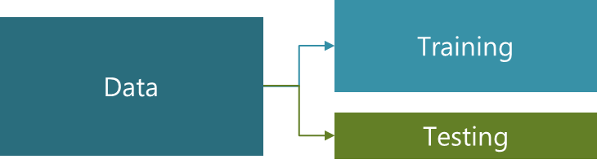
Hold-Out Validation Method
In Hold-Out validation method, available data is split into two non-overlapped parts: 'Training Data' and 'Testing Data'
The model is,
  Developed using training data
  Evaluated using testing data
Training data should have more sample size. Typically 70%-80% data is used for model development.
Root Mean Squared Error (RMSE) is used to validate the model performance on test data

Slide 15

Root Mean Squared Error (RMSE) in Linear Regression
What Is RMSE?
Root Mean Squared Error (RMSE) is a widely used metric for evaluating the accuracy of linear regression models. It measures the average magnitude of prediction errors, providing insight into how well your model fits the data. Lower RMSE values indicate better model performance, as they represent smaller differences between predicted and actual values.
RMSE is particularly useful because it penalises larger errors more heavily than smaller ones, making it sensitive to outliers. This characteristic helps identify models that may perform poorly on specific data points.
The Formula
Where:
n = number of observations
y_{i} = actual value
y^​_{i}​ = predicted value
Interpretation
RMSE is expressed in the same units as the target variable, making it intuitive to interpret
Model Comparison
Compare RMSE values across different models to identify the best-performing approach
Sensitivity
More sensitive to outliers than other metrics like Mean Absolute Error (MAE)

Slide 16
Cross Validation in Predictive Modeling
K-Fold Cross-Validation
In k-fold cross-validation the data is first partitioned into k equally (or nearly equally) sized segments or folds.
Here k iterations of training and testing are performed such that each time one fold is kept aside for testing and model is developed using k-1 folds.
Model performance measure is aggregate measure based on above iterations.
For each iteration, RMSE value is computed and averaged to give single performance measure.
Note that in each iteration, the RMSE is computed for test fold data and not train data folds.

Slide 17
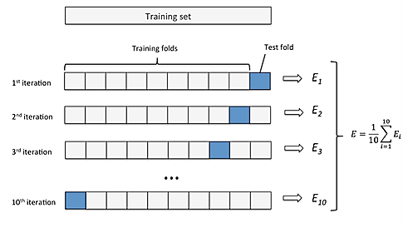
Cross Validation in Predictive Modeling
K-Fold Cross-Validation- Average RMSE

Slide 18
Repeated K-Fold Cross-Validation
K-fold cross-validation can be repeated 'm' times to arrive at more robust measure of model performance. Repeated k-fold CV does the same as above but more than once. For example, five repeats of 10-fold CV would give 50 total resamples that are averaged.
Important Note: This is not the same as 50-fold CV. The process requires computer with good computing power.
10
Typical Folds
Standard number of folds used in practice
5
Common Repeats
Number of times to repeat the process
50
Total Resamples
Five repeats of 10-fold CV

Slide 19
Cross Validation in Predictive Modeling
Leave-One-Out Cross-Validation(LOOCV)
Leave-one-out cross-validation (LOOCV) is a special case of k-fold cross-validation where k equals the sample size (k=n)
Let observation number i is kept aside. The model is developed using the remaining data. Observation number i is predicted using the model and error is computed.
The process is repeated for all i ( repeated n times).
RMSE is computed based on these predicted residuals. The method is computationally very intensive for large datasets.

Slide 20
Cross Validation in Predictive Modeling
Leave-One-Out Cross-Validation(LOOCV)
Sample size is 10 and one observations (say 7) is chosen to be kept aside
The model is developed on the new sample with n=9 and observation 7 is predicted. The process is repeated for each observation as “Test Observation”
1
2
3
4
5
6
7
8
9
10
1
2
3
4
5
6
8
9
10
7

Slide 21
Multiple Linear Regression: Key Takeaways
Inferential vs. Machine Learning
Inferential approaches focus on understanding relationships and statistical significance (p-values, confidence intervals), while ML prioritizes predictive accuracy on unseen data using metrics like RMSE and cross-validation.
Model Evaluation
RMSE measures average prediction error magnitude and is sensitive to outliers. Out-of-sample validation provides realistic performance estimates, as in-sample metrics tend to be overly optimistic about model quality.
Cross-Validation Methods
Four essential techniques exist: Hold-Out (70-80% train/test split), K-Fold (k iterations with rotating test folds), Repeated K-Fold (multiple iterations for robustness), and LOOCV (n iterations where k=n).
Practical Considerations
ML models require larger datasets and use regularization techniques for overfitting control. Variable selection is based on predictive value rather than statistical significance, though this may reduce interpretability compared to inferential models.

